Slide 1

INTEGRAL MATERIAL AND ENERGY FLOW MANAGEMENT IN MANUFACTURING METAL MECHANIC SECTOR
Joseba Bilbatua
MEMAN Coordinator
Senior Manager International Projects MONDRAGON CORPORATION
FoF for Automotive Workshop
February 28, 2018 – Brussels

Slide 2
Agenda
1
Introduction
2
Background
3
Concept & Implementation
4
Exemplary Application
5
Conclusions & Outlook

Slide 3
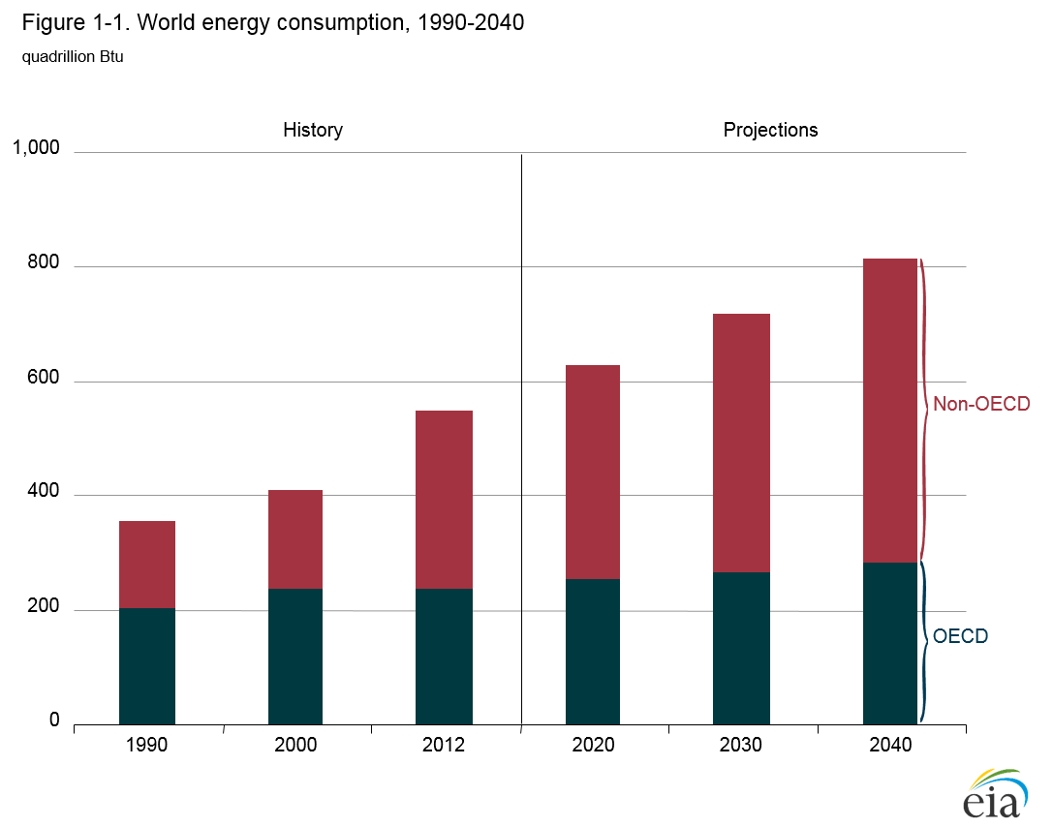
Introduction
The energy and material consumption in manufacturing over the next 20 years is expected to increase by 40%
Strategies to improve the economic and environmental performance of companies are usually pursued from a local perspective
source

Slide 4
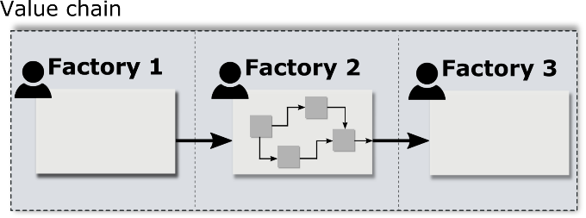

Introduction
Imagine you are the production manager of a producing factory,
which is embbedded in a value chain with two other factories.
You

Slide 5
Introduction
You are very motivated to reduce resource demands.
We have commited to save MONEY and the ENVIRONMENT!

Slide 6
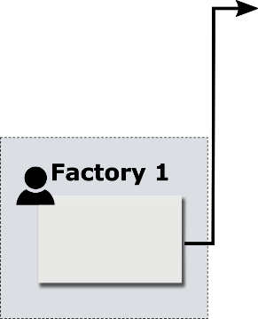
Introduction
You convince your CEO about your new idea.
  We change our raw material supplier!
The new material is less costly.

Slide 7


Introduction
Meanwhile, at the factory of your industrial customer…
  We’ll miss our sustainability targets…
KPI
  We need to order more raw parts!
  We have lots of defective parts now!

Slide 8
Introduction
Have you taken a good decision? Who benefits and who loses?
?
?
?
?
Methods and tools are needed to…
Identify interdependencies & target conflicts
Avoid problem shiftings
Find hidden resource saving potentials
MEMAN is developing a toolbox to enhance resource and energy efficiency for single factories and entire value chains alike

Slide 9
Agenda
1
Introduction
2
Background
3
Concept & Implementation
4
Exemplary Application
5
Conclusions & Outlook

Slide 10
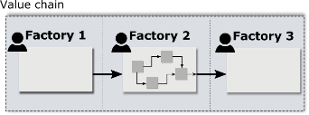




Background
Focus of methods regarding life cycle phases
Cradle to grave
Gate to gate
LCA
MEFA
EVSM
Simulation
Raw Material
Production
Manufacturing
Product Use
End of Life

Slide 11
Background
Selected methods to analyse resource efficiency & sustainability of production systems:
MEFA (Material & Energy Flow Analysis): Analysis of material & energy input/output balances
LCA (Life Cycle Assessment): Analysis of environmental impacts due to resource consumptions & emissions
EVSM (Energy Value Stream Management): Analysis of manifold wastages along the value stream
Factory Simulation: Analysis of dynamic consumption patterns
Complementary methods
→ Combine them to allow for a holistic assessment of factories & value chains

Slide 12
Agenda
1
Introduction
2
Background
3
Concept & Implementation
4
Exemplary Application
5
Conclusions & Outlook

Slide 13

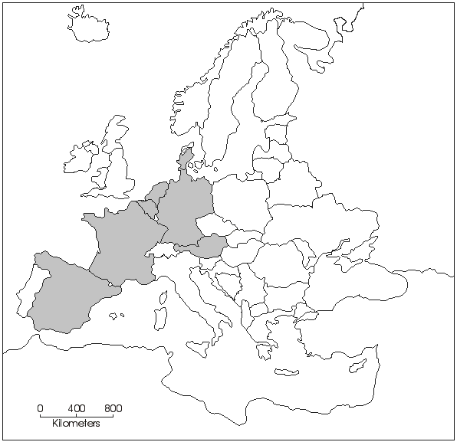













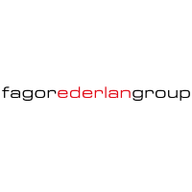
Concept & Implementation - Project Background & Approach
Project „MEMAN“: Design and apply toolbox to reveal resource saving potentials in value chains of European metal mechanic industry.
  www.meman.eu
Funded by European Comission
Runtime: 2015 – 2018 (42 months)
Budget: ~ 6 mio. €
Beneficiaries: 14 + 11 Linked Third Parties
    72% (18) are industries both Large and SMEs
    23% (7) are RTD partners

Slide 14
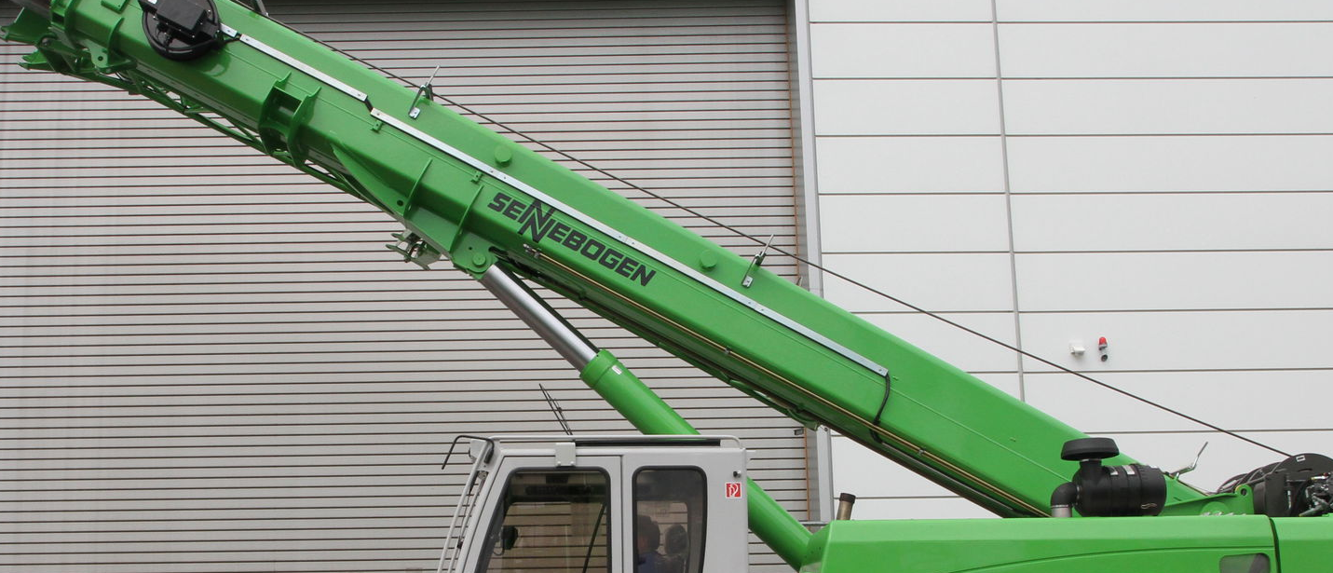
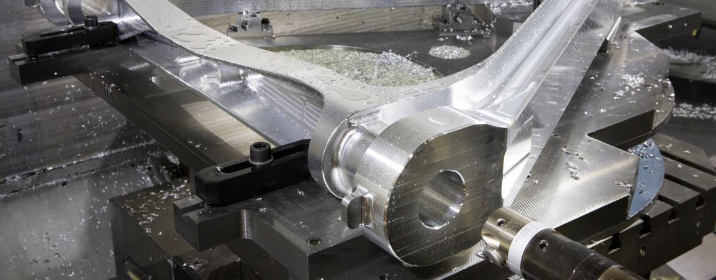
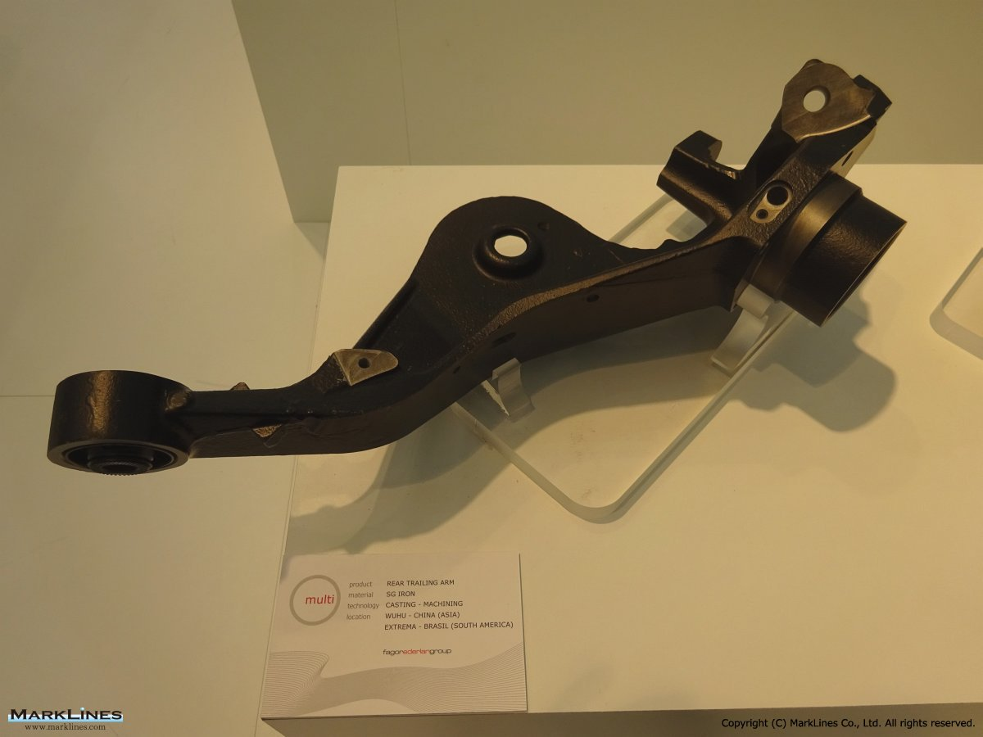
Exemplary Application – Configuration of Value Chain (Use cases)
Product: Piston rod, Steel (42CrMo4), used in caterpillars & cranes
Product: Structural aerospae components (Aluminium, Titanium)
Image Source: http://www.figeac-aero.com/
Machining Cluster
Surface Finishing Cluster
Image Source: http://www.directindustry.de/
Product: Control arm for
automotive (Aluminium),
Casting Cluster

Slide 15
Concept & Implementation - Project Background & Approach
Project „MEMAN“: Design and apply toolbox to reveal resource saving potentials in value chains of European metal mechanic industry.
  www.meman.eu
Local Factory Data
Decision-making Toolbox
calculates saving potentials
identifies interdependencies & target conflicts
Global Improvement Recommendations

Slide 16
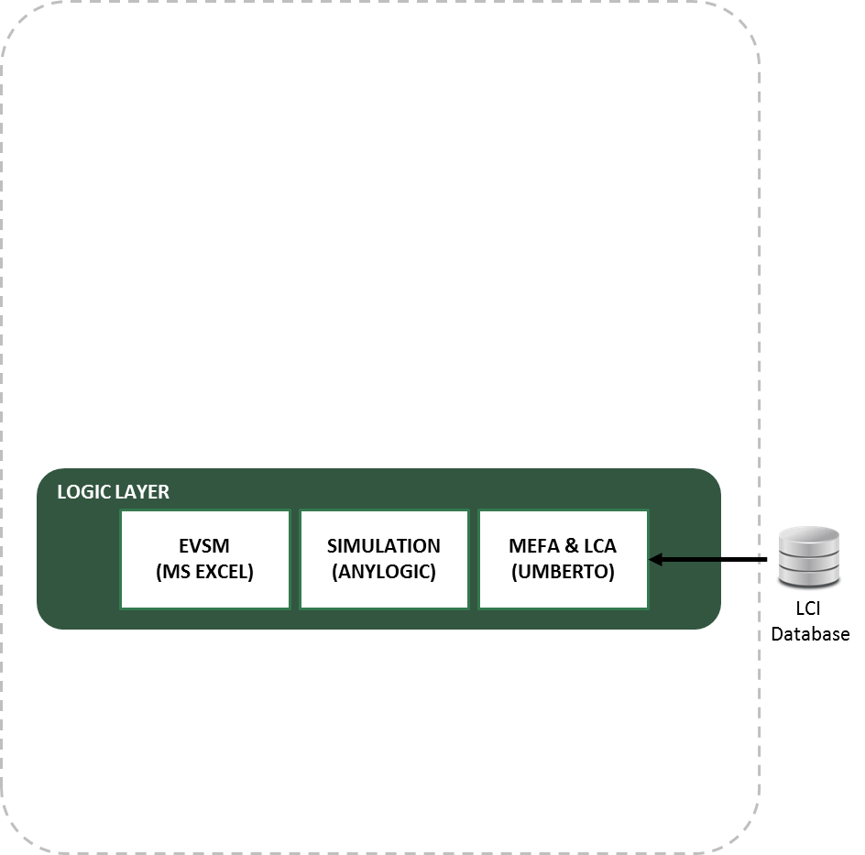
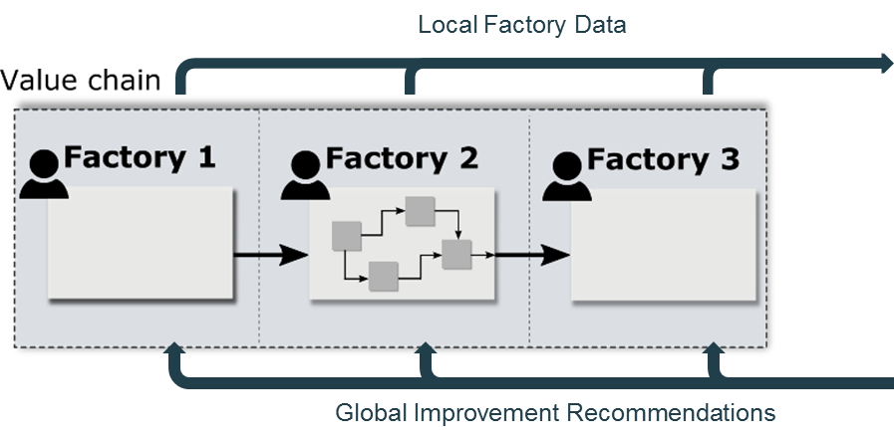
Concept & Implementation – Toolbox Concept
Decision-making Toolbox
3 application paths
  User perspective: 3 paths applied independently or combined (depending on targets & data availability)

Slide 17
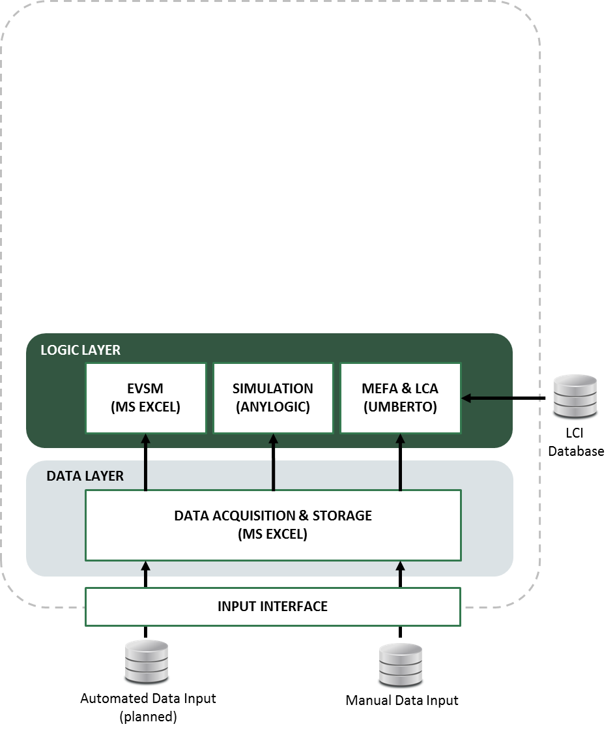
Concept & Implementation – Toolbox Concept
Decision-making Toolbox
3 application paths
  User perspective: 3 paths applied independently or combined (depending on targets & data availability)
  Fed with consistent data

Slide 18
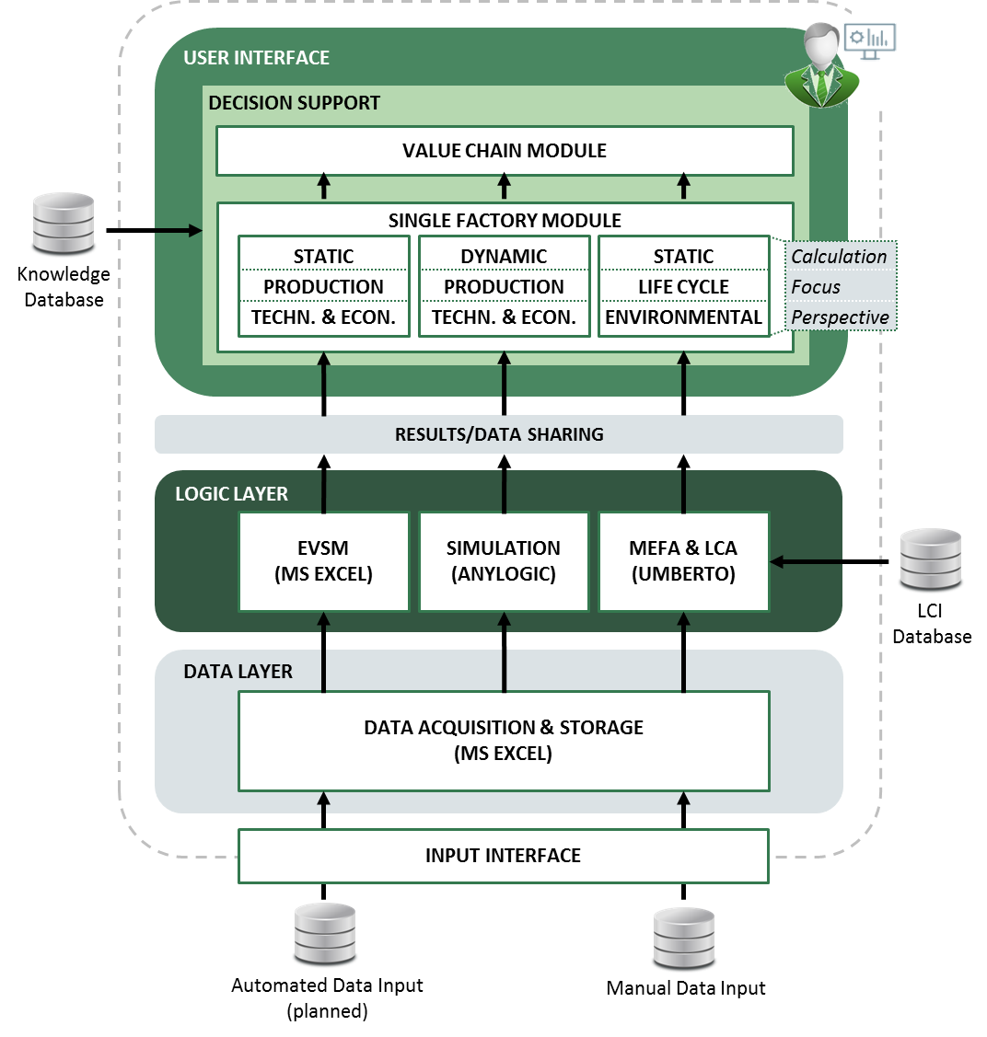
Concept & Implementation – Toolbox Concept
3 application paths
  User perspective: 3 paths applied independently or combined (depending on targets & data availability)
  Fed with consistent data
  Results consolidated for decision support

Slide 19

Concept & Implementation – Application Paths
EVSM*
Quick hotspot identification
  Capacities / Bottlenecks (static)
  Product Quality
  Energy Demands
  Costs
Results
* Energy Value Stream Management

Slide 20
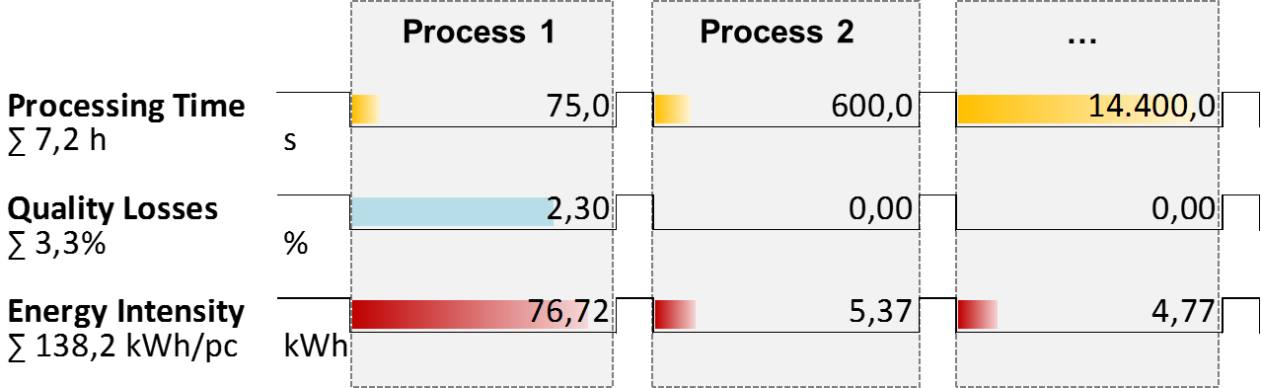
Concept & Implementation – Application Paths
EVSM*
Quick hotspot identification
  Capacities / Bottlenecks (static)
  Product Quality
  Energy Demands
  Costs
Results
* Energy Value Stream Management

Slide 21
Concept & Implementation – Application Paths
Factory Simulation
Dynamic system behaviour understanding
  Demand profiles
  Inventories
  Machine utilisation
  Lead Times
Results
Factory Load Profile
Lead Times per Batch
Machine Load Profiles
Machine Queing Times
Energy per Batch

Slide 22
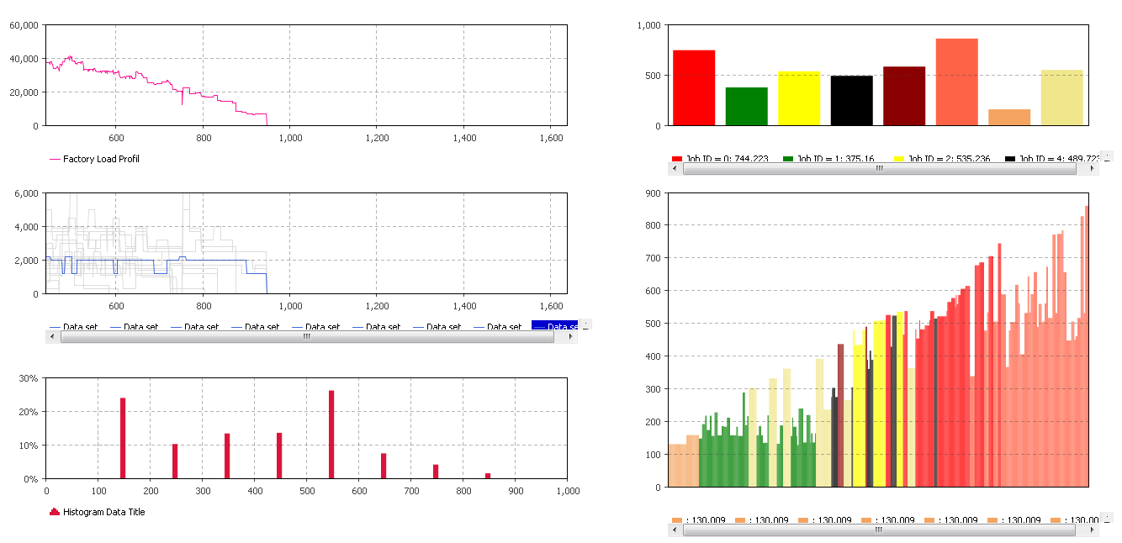
Concept & Implementation – Application Paths
Factory Simulation
Dynamic system behaviour understanding
  Demand profiles
  Inventories
  Machine utilisation
  Lead Times
Results
Factory Load Profile
Lead Times per Batch
Machine Load Profiles
Machine Queing Times
Energy per Batch

Slide 23
Concept & Implementation – Application Paths
MEFA* & LCA**
Environmental impact assessment
  Carbon Footprint
  Toxicity
  Eutrophication
  …
Results
* Material & Energy Flow Analysis
** Life Cycle Assessment

Slide 24
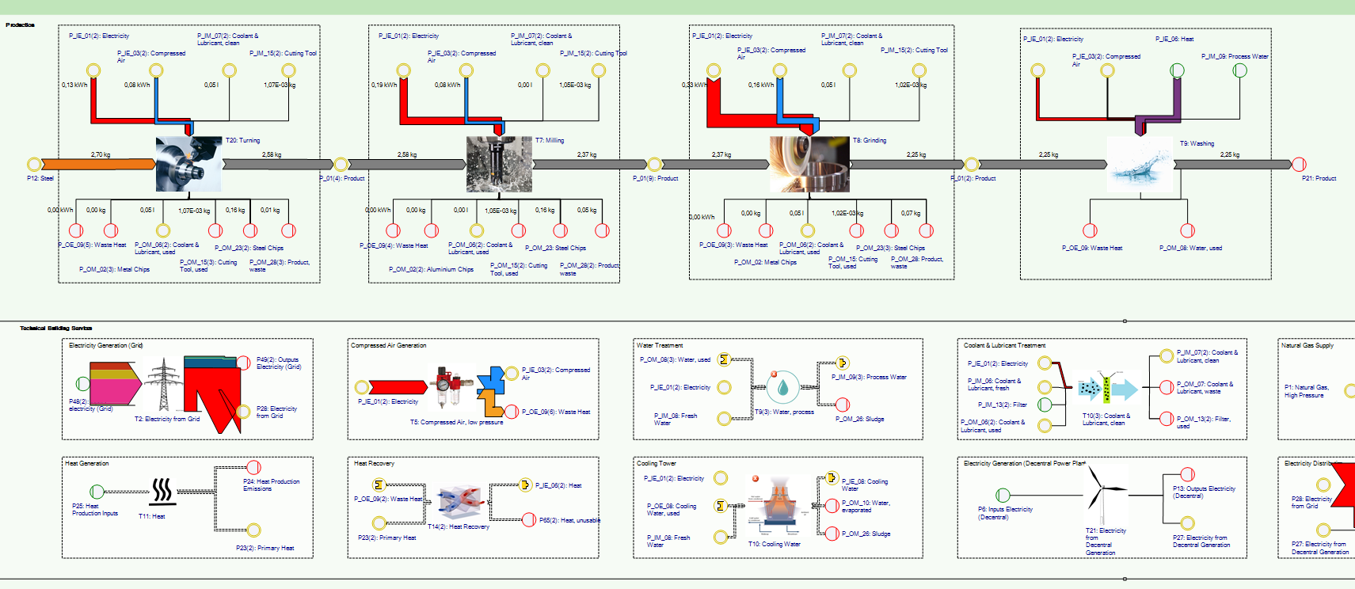
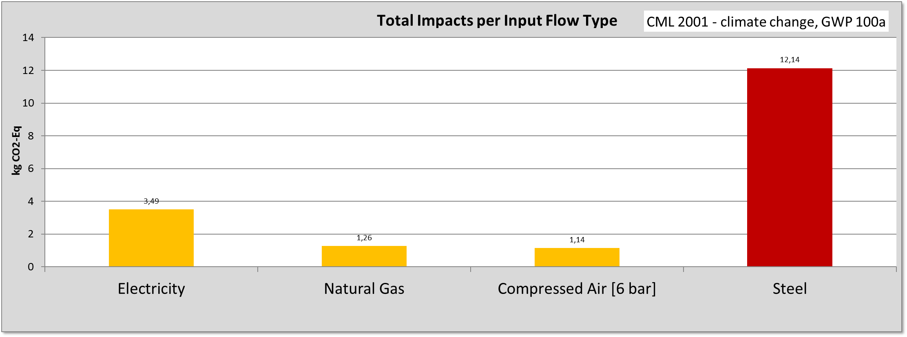
Concept & Implementation – Application Paths
MEFA* & LCA**
Environmental impact assessment
  Carbon Footprint
  Toxicity
  Eutrophication
  …
Results
* Material & Energy Flow Analysis
** Life Cycle Assessment

Slide 25
Concept & Implementation – Application Paths
Value Chain Module
KPI Monitor
Overview for all calculations

Slide 26
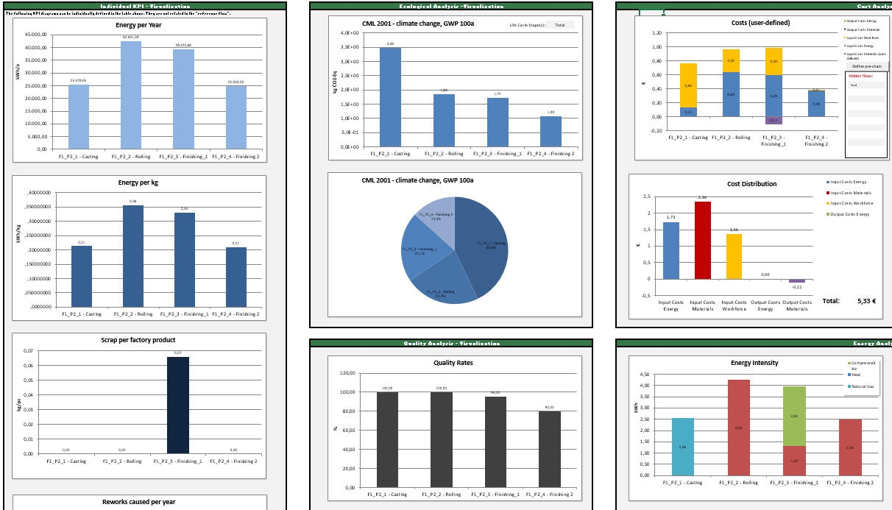
Concept & Implementation – Application Paths
Value Chain Module
KPI Monitor
Overview for all calculations

Slide 27
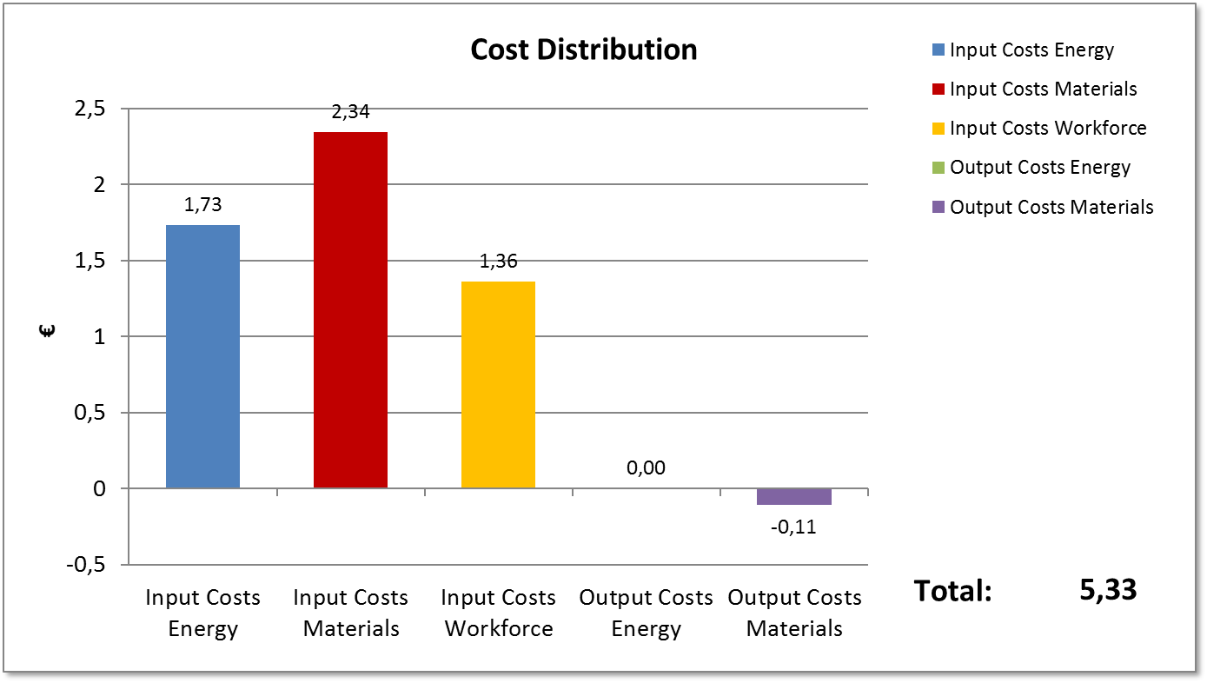
Concept & Implementation – Application Paths
KPI Monitor
Overview for all calculations

Slide 28
Agenda
1
Introduction
2
Background
3
Concept & Implementation
4
Exemplary Application
5
Conclusions & Outlook

Slide 29
Exemplary Application – Configuration of Value Chain (Use cases)
Product: Piston rod, Steel (42CrMo4), used in caterpillars & cranes
Product: Structural aerospae components (Aluminium),
Image Source: http://www.directindustry.de/
Image Source: http://www.figeac-aero.com/
Product: Control arm for
automotive (Aluminium),

Slide 30
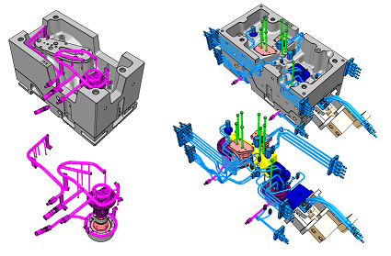
Exemplary Application – Base Scenario
Product: Control Arm , Aluminium, used in automotive applications
CONVENTIONAL SOLID CASTING | HOLLOW CASTING
Central single feeding | Multiple feeding points
Simple cooling circuits for solidification | Sophisticated passive and active thermal management based solutions for solidification
 | Higher productivity
 | Higher effort in design phase

Slide 31
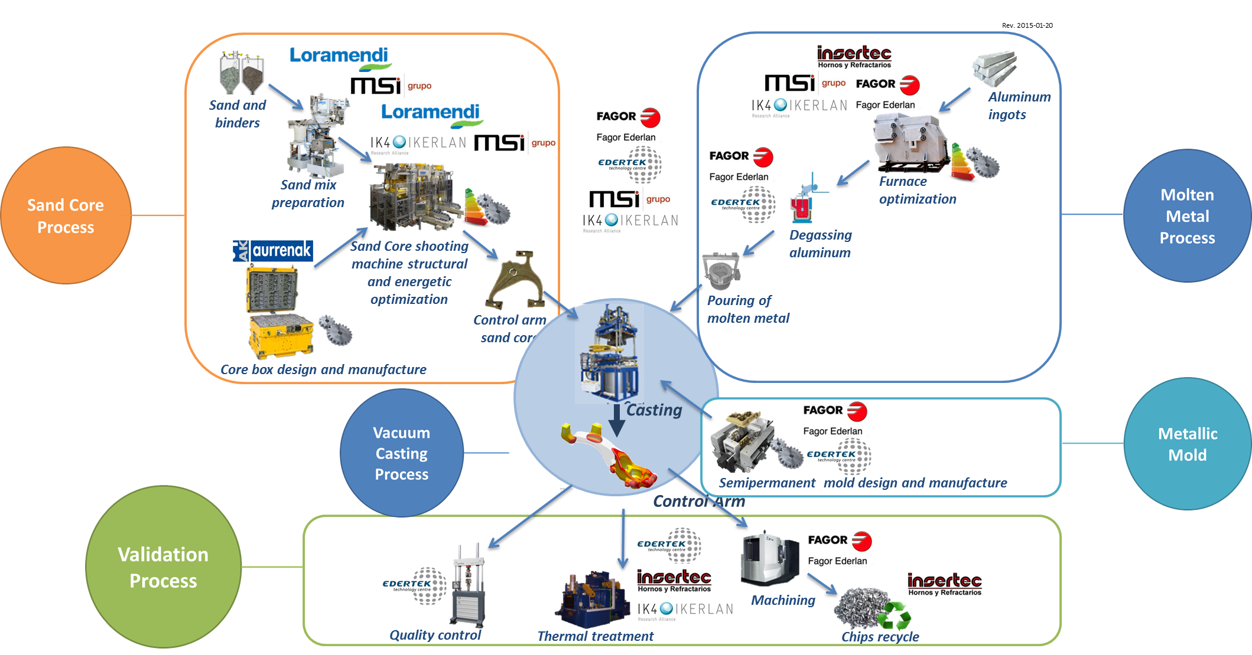
Exemplary Application – Base Scenario
Product: Control Arm , Aluminium, used in automotive applications

Slide 32
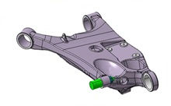

Exemplary Application – Base Scenario
Product: Control Arm , Aluminium, used in automotive applications
Inputs
Outputs
Raw Aluminium
Finished Products
Energies
Water
Emissions
Auxiliaries
Workforce
Waste
Main Processes:
Tooling
Sand core making
Vacuum casting
Melting ovens
Chips recycling
Sand recycling

Slide 33
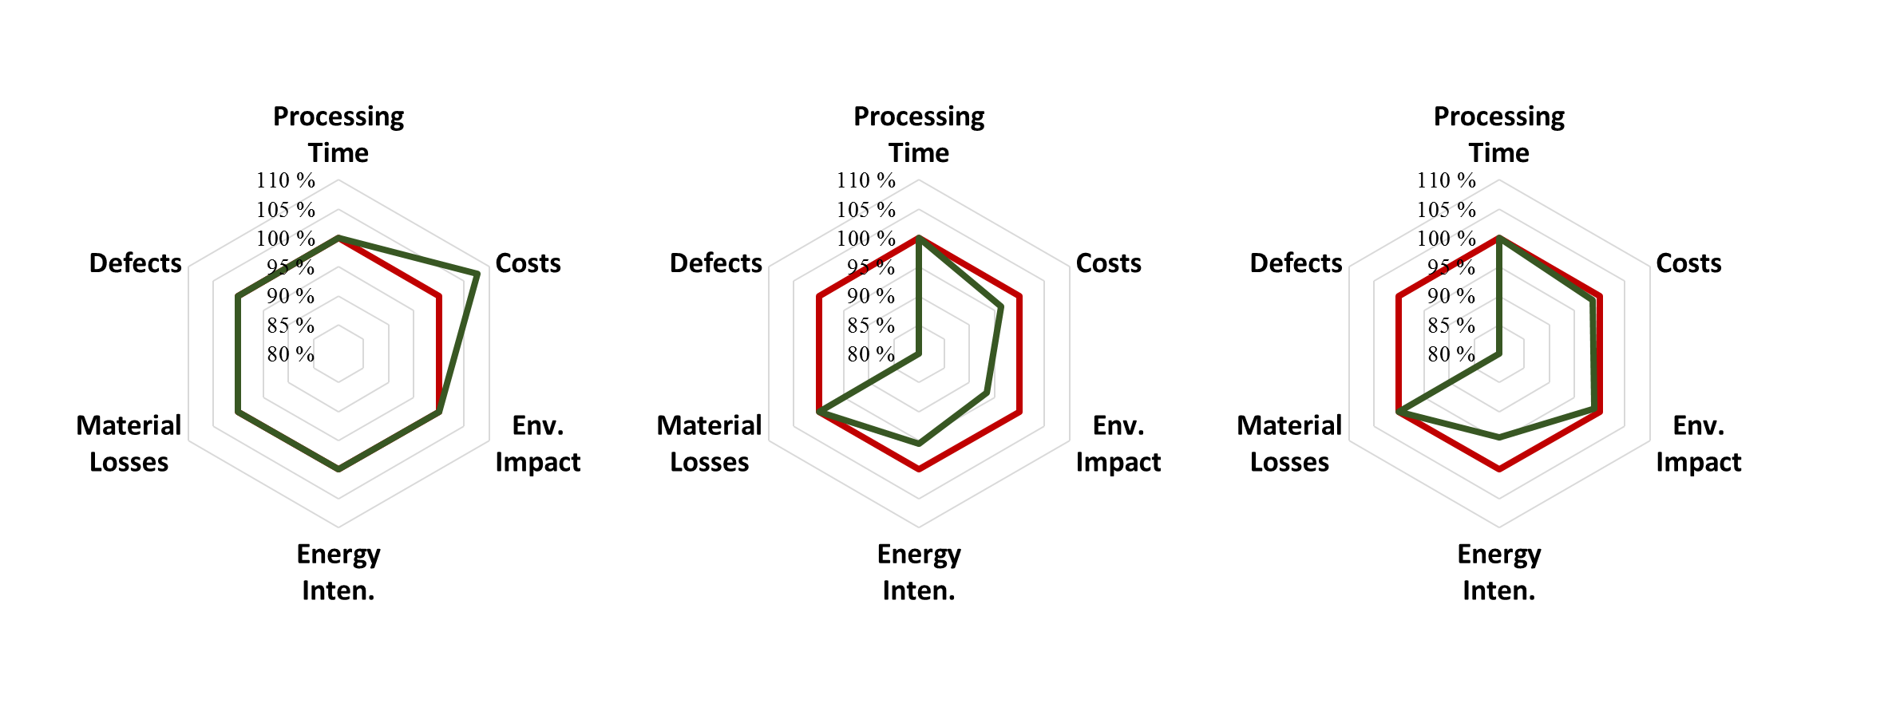
Exemplary Application – Alternative Scenarios
  Base scenario
  Improved scenario*
  + 7,6 %
*Aluminium price increase by 10 % & quality rates of 7 processes increased by 1 %

Slide 34
Exemplary Application – Alternative Scenarios
  Base scenario
  Improved scenario*
  + 7,6 %
  - 9,8 %
*Aluminium price increase by 10 % & quality rates of 7 processes increased by 1 %

Slide 35
Exemplary Application – Alternative Scenarios
  Base scenario
  Improved scenario*
  + 7,6 %
  - 9,8 %
  - 1,4 %
*Aluminium price increase by 10 % & quality rates of 7 processes increased by 1 %

Slide 36
Agenda
1
Introduction
2
Background
3
Concept & Implementation
4
Exemplary Application
5
Conclusions & Outlook

Slide 37
Conclusions
Complementary methods combined in one environment
Holistic evaluation of factories and value chains
High degree of transparency
Target conflicts can be overcome with new business models
Decision support on strategical and tactical level considering e.g.…
Material changes/substitution
Input-/Output quantity changes
Process parameter changes
Production schedule changes
Limitations & development potentials
High data acquisition effort
Experts needed to verify results
Multi product consideration
Detailed modeling of technical building services
  Publication: „Toolbox for Increasing Resource Efficiency in the European Metal Mechanic Sector”
  Available with open access: http://www.sciencedirect.com/science/article/pii/S2212827116314160

Slide 38
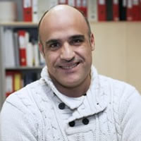

Contact
  MONDRAGON CORPORATION
Innovation & Technology department
http://www.mondragon-corporation.com/
Thanks for your attention
www.meman.eu
  Dipl. MSc Joseba BILBATUA
  Responsible for Advanced Manufacturing and Raw Materials
  MONDRAGON Corporation Headquarter
  jbilbatua@mondragoncorporation.com

